Slide 1


SOCIAL BUZZ

Slide 2


Today's agenda
Project recap
Problem
The Analytics team
Process
Insights
Summary

Slide 3

Social buzz is a fast growing technology unicorn that need to adapt quickly to it’s a global scale . Accenture has been a 3 month POC focusing on these task
An audit of social buzz's big data practice
Recommendations for a successful IPO
Analysis to find social buzz's top 5 most popular categories of content.
Project Recap

Slide 4

Problem
Over 100000 post per day
36,500,000 pieces of content per year!
But how to captialize on it when there is so much ?
Analysis to find the social buzz's top5 most popular categories of content

Slide 5



Andrew fleming
Chief technical architect
The Analytics team
Marcus rompton
Senior principle
Yogesh
Data analyst

Slide 6
Process
1
Data understanding
2
Data cleaning
3
Data modelling
4
Data analysis
5
Uncover insight

Slide 7

Insights
16
1897
JANUARY
MONTH WITH MOST POST
UNIQUE CATEGORIES
REACTION TO ANIMAL POST

Slide 8
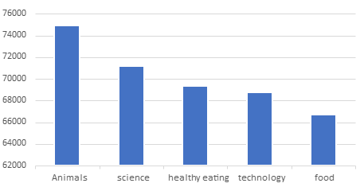
TOP 5 CATEGORIS BY AGGREGATED BY POPULARITY SCORE

Slide 9
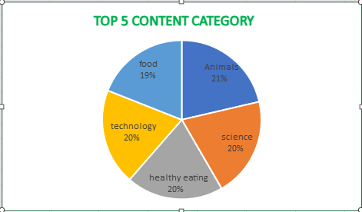

Slide 10

ANALYSIS
Animals and science are the two most popular categories of content, showing that people enjoy "real life" and "factual" content the most.
INSIGHT
FOOD IS A COMMON THEME WITH TOP 5 CATEGORIES WITH HEALTH EATING ,ranking the highest. this may give an indicate to the audience within your user base, you could use this insight to create a campaign and work with healthy eating brands to boost user engagement.
Summary
NEXT STEPS
THIS ad-hoc analysis is insightful, but it's time to take this analysis into large scale production for real-time understanding of your business .we can show you how to do this.

Slide 11
Thank you!
ANY QUESTIONS?

